Slide 1
Lecture 4
D&D Chapter 5 Methods including scope and overloading

Slide 2
Goals
By the end of this lesson, you should
know how to write a method and call it
know how to write an overloaded method and call it.
know how to call a Java API static or non-static method
understand the difference between static and non-static methods
understand the basics of scope

Slide 3
Calling Java Methods
Method calls
Declarations
Static and non-static methods
Scope and call stack
Java API
Summary
System.out.println( "The smallest float number from Math.min is " + Math.min(number1,Math.min(number2,number3)));
System and Math are special classes that are always available and the methods are static so can be called directly without instantiating a System or Math object – this is another Java ‘cheat’.
import java.util.Scanner;
…
Scanner input = new Scanner(System.in);
double number1 = input.nextDouble();
Scanner obeys the OO rules:
you have an import to explicitly include the java library
you must declare and instantiate a scanner object (named input here)
then you can call the .nextDouble() method

Slide 4
Method declarations
public static void main(String[] args) {
….
double result = maximum(number1,number2, number3);
….
}
public static double maximum(double x, double y, double z){
………
return biggest; }
Method calls
Declarations
Static and non-static methods
Scope and call stack
Java API
Summary
This is dictated by Java
public can be seen by other objects/classes (alternative private or nothing)
static method can be use even if the object isn’t instantiated (this is pretty ugly and not pure OO avoid wherever possible. Here the method must be static because it is being called by a static method - main() unless we instantiate the class again inside itself (recursion).
double the data type the method will return
maximum the method name – something you make up, first letter small. (double x,….) the parameters to be passed to the method, each typed

Slide 5
Method overloading
double result = maximum(int1, int2, int3);
We could call the maximum method, passing it integers int1, int2, and int3 instead of doubles. Java will ‘promote’ them to doubles. It will do this anytime you will not lose data (e.g., int or float to double, but not double to float or float to int). Alternatively”, we could have another method of the same name with a different signature, i.e.:
public static int maximum(int x, int y, int z){… }
Java will use the method with the best signature match. If you passed a mix of doubles and ints, it would use the double version because it can promote the ints to doubles but not the other way around. You could have another maximum() that takes 4 values…
This is called method overloading.
How many overloads does Math.min() have?
Method calls
Declarations
Static and non-static methods
Scope and call stack
Java API
Summary

Slide 6
Type casting variables
int intResult = (int) maximum(int1,int2,int3);
We can also explicitly change the type of something in a statement. So we could use the double maximum method and type cast the return value to an integer.
Type casting can be done in almost any statement by putting the destination type before the variable in ()
You must to be aware that you can lose data!
double doubleX = 2.8;
intX = (int) double; // What will be in intX?
Answer?
There is of course Math.round()
int intResult = Math.round(maximum(int1,int2,int3));
Method calls
Declarations
Static and non-static methods
Scope and call stack
Java API
Summary

Slide 7
static methods
Method calls
Declarations
Static and non-static methods
Scope and call stack
Java API
Summary
Java knows two types of methods:
Non-static methods (sometimes also known as “object methods” or “member methods”). These are declared in the class but can only be called (invoked) on an actual instance (object) of the class. Non-static methods can work with data stored in the object.
Static methods (=declared as static). Also known as “class methods”. These are also declared in the class but don’t require an actual instance of the class to be called. Because of this, static methods cannot work with data stored in objects of the class.

Slide 8
static methods
Method calls
Declarations
Static and non-static methods
Scope and call stack
Java API
Summary
Non-static methods we have met: nextDouble() in Scanner objects, but we’ll soon meet more. In fact, most methods in practice are not static.
Static methods we have met: main(), maximum(), Math.min()

Slide 9
Three types of method calls
Method calls
Declarations
Static and non-static methods
Scope and call stack
Java API
Summary
Call a method in the same class
returnVar = methodName(parameters);
2. Call a Java static method (aka “class method”):
returnVar = ClassName.methodName(parameters);
3. Call a non-static method in another class
import ……
…
ClassName objectName = new ClassName();
returnVar = objectName.method(…);

Slide 10
Scope
Method calls
Declarations
Static and non-static methods
Scope and call stack
Java API
Summary
Classes, objects, methods and variables all have a scope:
The scope of a class is/are the section(s) of code in which we can, e.g., declare variables to be of type of the class, instantiate objects of the class and call class methods.
The scope of a method is/are the section(s) of code in which we can invoke the method.
The scope of a method is/are the section(s) of code in which we can read the variable or assign it a value.
Scope is governed by where something is defined and what visibility modifiers it has:
public: visible to code anywhere
private: visible to code inside the class only
Generally, everything is in scope within the code block in which it is defined.

Slide 11
Scope
Method calls
Declarations
Static and non-static methods
Scope and call stack
Java API
Summary
public class Dog {
public String name;
public void come() {
System.out.println("You called " + name + "? Rushing to you...");
}
public void behave() {
sleep();
chewSomething();
}
private void sleep() {
System.out.println("Zzzzzz...");
System.out.println("Waking up...");
}
private void chewSomething() {
System.out.println("Chewing your favourite shoe...");
}
}

Slide 12
Scope
Method calls
Declarations
Static and non-static methods
Scope and call stack
Java API
Summary
public class Scope {
public static void main(String[] args) {
// Can instantiate a Dog because it's a public class
Dog myDog = new Dog();
myDog.name = "Patsy";
// Can call come() method on myDog object because
// come() is public
myDog.come();
// Can call behave() method on myDog object because
// behave() is public
myDog.behave();
// Can't call sleep() method on myDog object because
// sleep() is private.
//The following line won't compile.
// myDog.sleep();
}
}

Slide 13
Stack and scope
A method must know where to return control when it completes. The program builds a call stack.
Think of it as a stack of plates: The most recent call (plate) is on the top – when it finishes control is passed to the next entry (plate) down.
Calls are ‘pushed’ onto the top of stack and ‘popped’ off the top.
Method calls
Declarations
Static and non-static methods
Scope and call stack
Java API
Summary
System.out.println()
myDog.ChewSomething()
myDog().sleep()
System.out.println()
myDog().come()
myDog().behave()
Scopes::main()

Slide 14
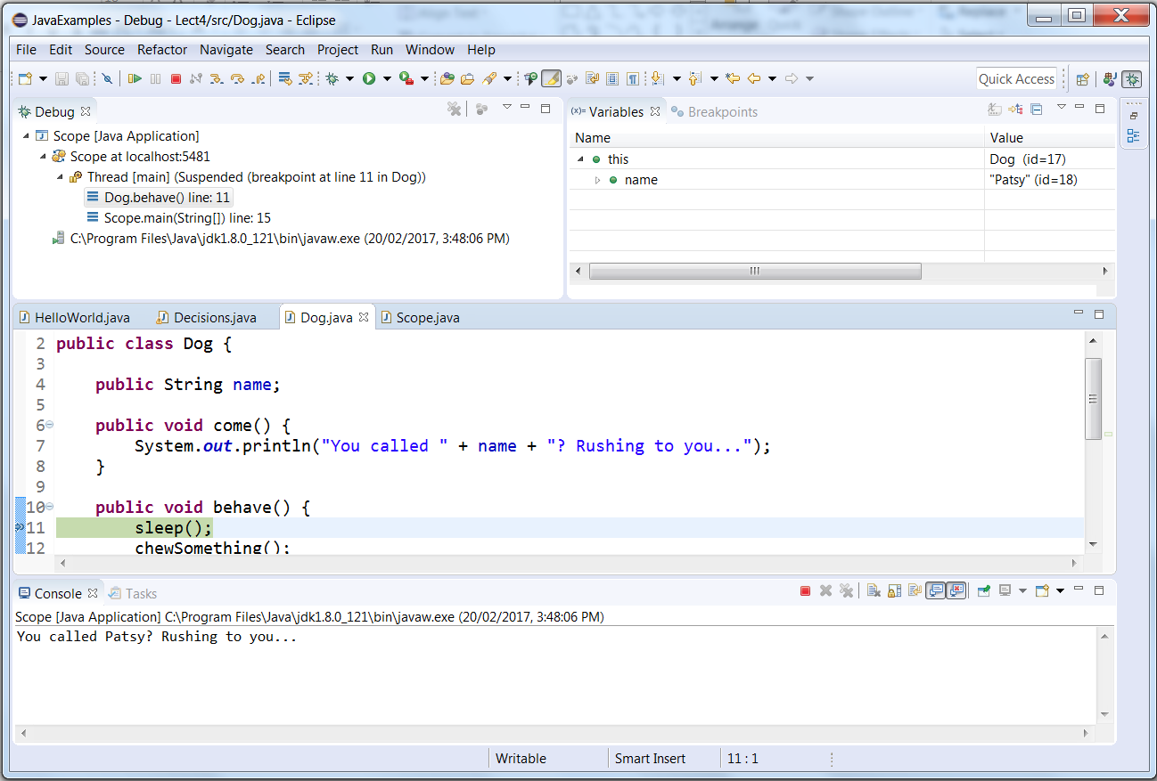
Stack and scope
You can see the stack and the in-scope variables in the debugger
Method calls
Declarations
Static and non-static methods
Scope and call stack
Java API
Summary
stack
In scope variables

Slide 15
Variables in Java
Method calls
Declarations
Static and non-static methods
Scope and call stack
Java API
Summary
In Java, you declare variables in four contexts:
Inside a method: These variables are for the method to work with and are not visible outside the method.
Outside a method in a class: These variables are for the methods of the class to use and, if declared public, can be set and read by code outside the class.
As normal variables (non-static). If declared outside a method, each object (instance) of the class gets its own copy of the variable. If we change the value in one instance, the copies in the other instances don’t change.
As static variables. These are declared outside a method only. There is only a single copy of the variable, and we need no object instance to be able to read or write to the variable. Static and non-static methods can work with static variables.

Slide 16
Java API
Method calls
Declarations
Static and non-static methods
Scope and call stack
Java API
Summary
You may have wondered where Scanner and Math came from.
Java provides you with a huge number of ready-made classes, which in turn contain many more methods, both static and non-static, and in many cases overloaded multiple times.
We will see more and more examples as we go. A few you will use include:
java.util
Math
java.awt – graphics
javax.swing – gui components

Slide 17
What do we know
Method calls
Declarations
Static and non-static methods
Scope and call stack
Java API
Summary
Java method calls look different depending on whether
the method is in one of the special class (eg System or Math)
Is static – in which case you do not need to instantiate an object
Is non-static - when you do need to instantiate the object
Calling your own method in the same class requires just the method name and parameters
Declaring a method you include its
Scope (public or private)
Static if required (eg in the same class as main())
Return type
Name
Parameter list (type name, type name, …)
Code block braces ( {} )
You can overload methods by declaring multiple methods with the same name but different signatures
Different return type and/or
Different parameters
Java will choose the most appropriate match
You can change the type of something by casting it – you may lose data if you are not careful.
(type) variable

Slide 18
Resources
Method calls
Declarations
Static and non-static methods
Scope and call stack
Java API
Summary
D&D chapter 5
https://docs.oracle.com/javase/tutorial/java/javaOO/methods.html
Homework
Revision exercises in Chapter 5
Play with the lecture example code.

Slide 19
Next Lecture
D&D Chapters 6
Arrays and ArrayLists

